Slide 1
ARDUINO BASED HAND GESTURE CONTROLLED ROBOT USING ATMEGA32
Under the esteemed guidance of Dr . M.Ch.P Jagdissh
Prof and HOD , ECE
-Abhinav sharma(11J41A0402)
-S.Uday kumar(12J45A0409)

Slide 2
Contents:
Aim
Introduction
Block Diagram
Schematic
Transmitter Section
Receiver Section
Accelerometer
Hand Gestures
Conclusion
Applications

Slide 3
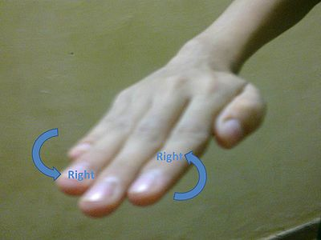
Aim
The prime aim of the design is that the robot and platform starts the movement as soon as the operator makes a gesture or posture or any motion.
The above movement enables user to control a remote vehicle or a robot just by means of a hand gesture

Slide 4
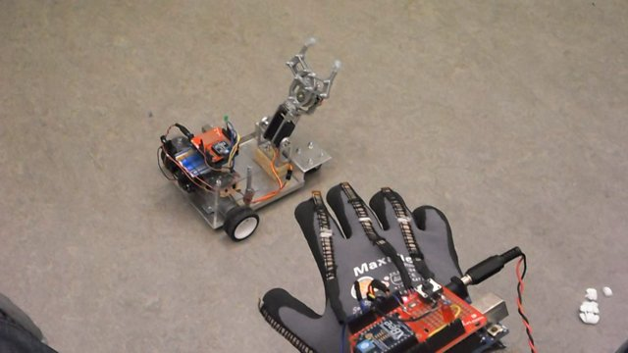
Introduction
A Gesture Controlled robot is a kind of robot which can be controlled by your hand gestures not by old buttons. You just need to wear a small transmitting device in your hand which included an acceleration meter. This will transmit an appropriate command to the robot so that it can do whatever we want.

Slide 5
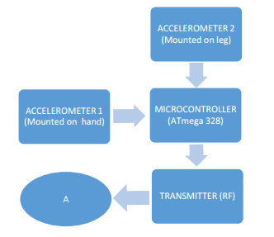
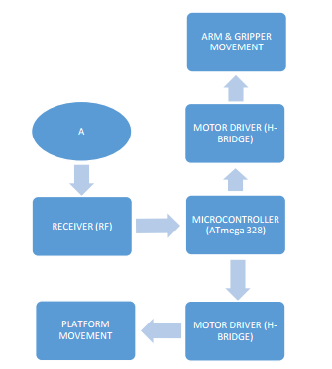
Block Diagram
Transmitter Receiver

Slide 6
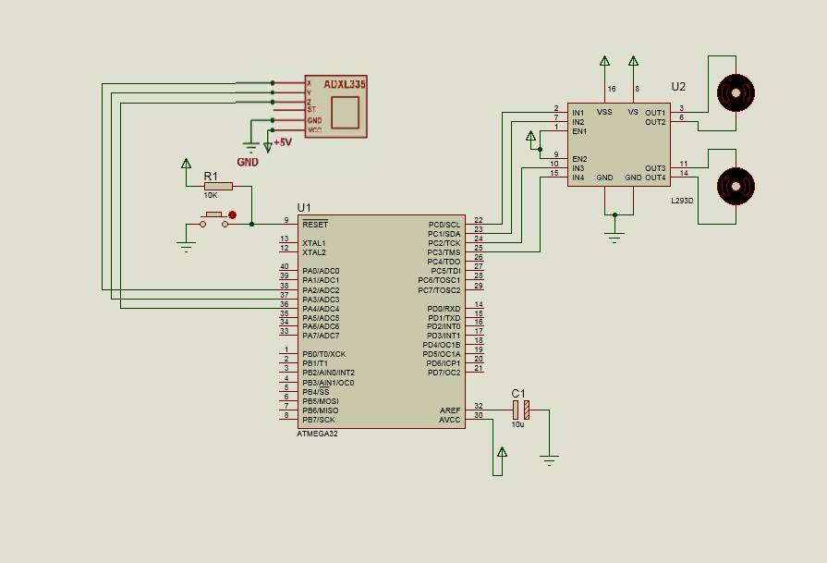
Schematic Diagram

Slide 7
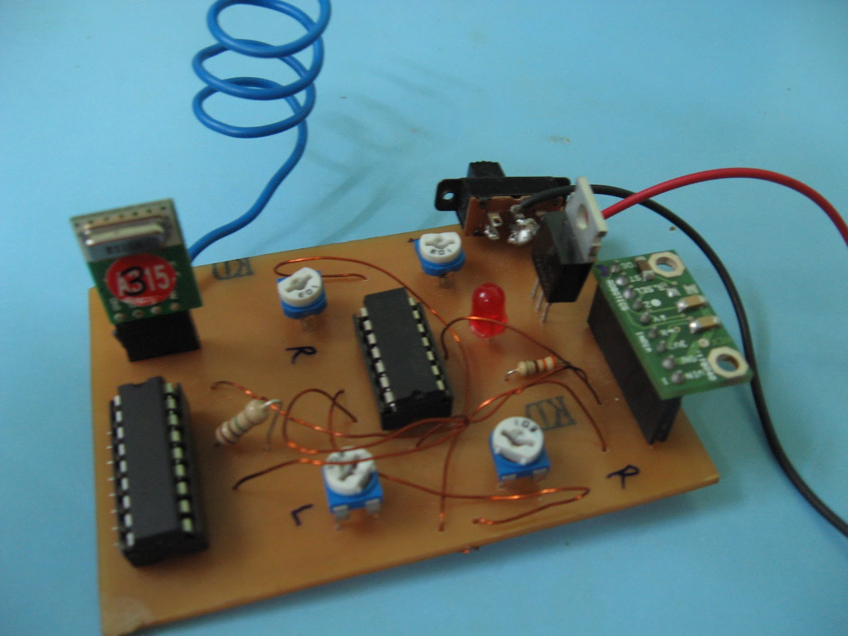
The transmitting device included a comparator IC for analog to digital conversion and an encoder IC(HT12E) which is use to encode the four bit data and then it will transmit by an RF Transmitter module.

Slide 8
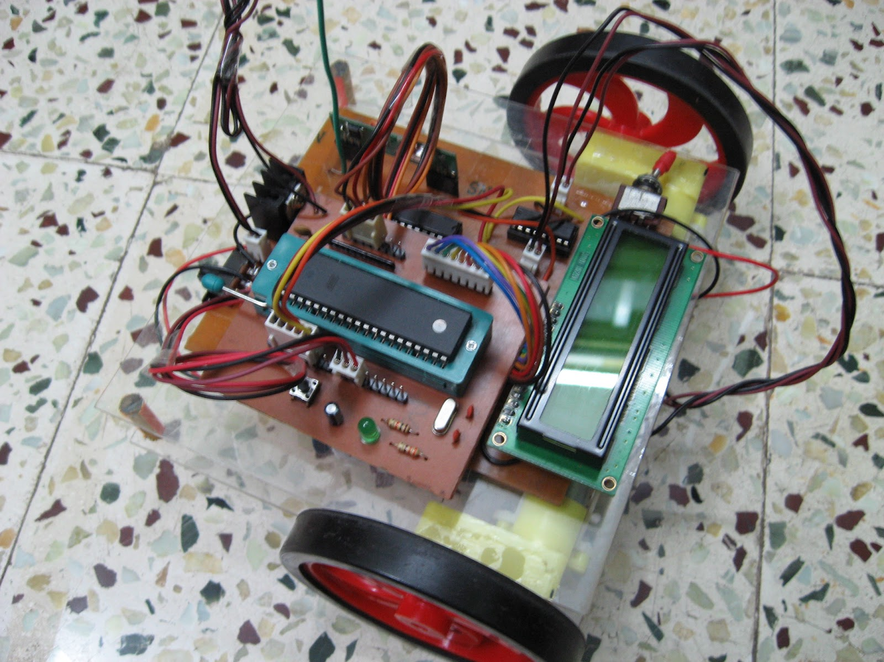
At the receiving end an RF Receiver module receive's the encoded data and decode it by an decoder IC(HT12D). This data is then processed by a microcontroller (P89V51RD2) and finally our motor driver to control the motor's.

Slide 9
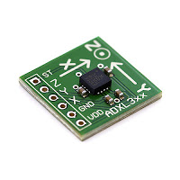
ACCELEROMETER
An Accelerometer is a kind of sensor which gives an analog data while moving in X,Y,Z direction or may be X,Y direction only depends on the type of the sensor. Here is a small image of an Accelerometer shown.
We can see in the image that there are some arrows. If we tilt these sensor in that direction then the data at that corresponding pin will change in the analog form.

Slide 10
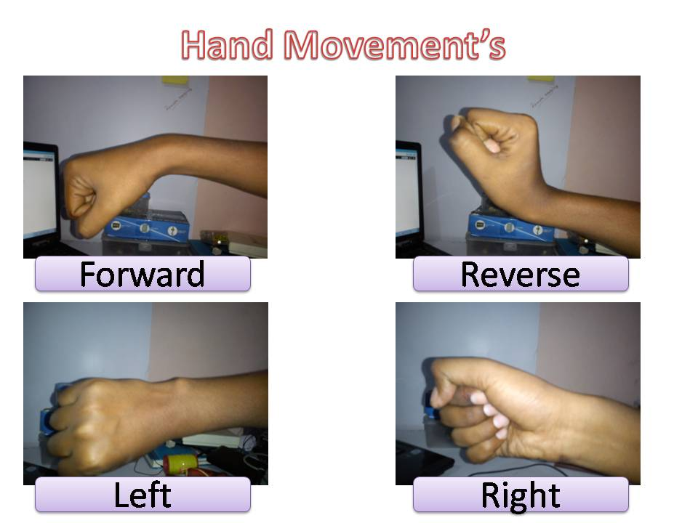
For forward the data to the Port2 is 0a or for backward it is 05 then for left its 02 and for right it is 08.

Slide 11
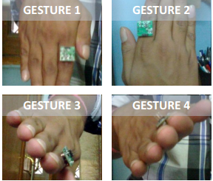
Conclusion
The Robot was synchronized with the gestures (hand postures) of the operator and the platform part is synchronized with the gestures (leg postures) of the operator.
The Robot was successfully able to regulate the output of the motors based on the movement of the Accelerometer and was able to move to the desired position

Slide 12
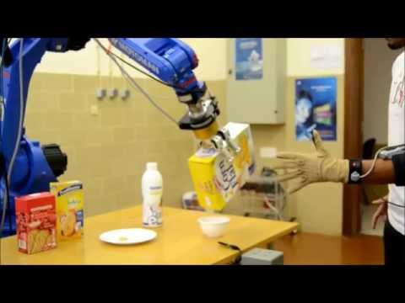
Applications
Robotic arms can be developed based on this application and they are the vital part of almost all the industries
This Gesture Recognition methodology has become increasingly popular in a very short span of time.
It can be employed in hazardous areas where human interaction can be fatal

Slide 13
THANK YOU

